Slide 1
Counting, Permutations, & Combinations

Slide 2
A counting problem asks “how many ways” some event can occur.
How many three-letter codes are there using letters A, B, C, and D if no letter can be repeated?
One way to solve is to list all possibilities.

Slide 3
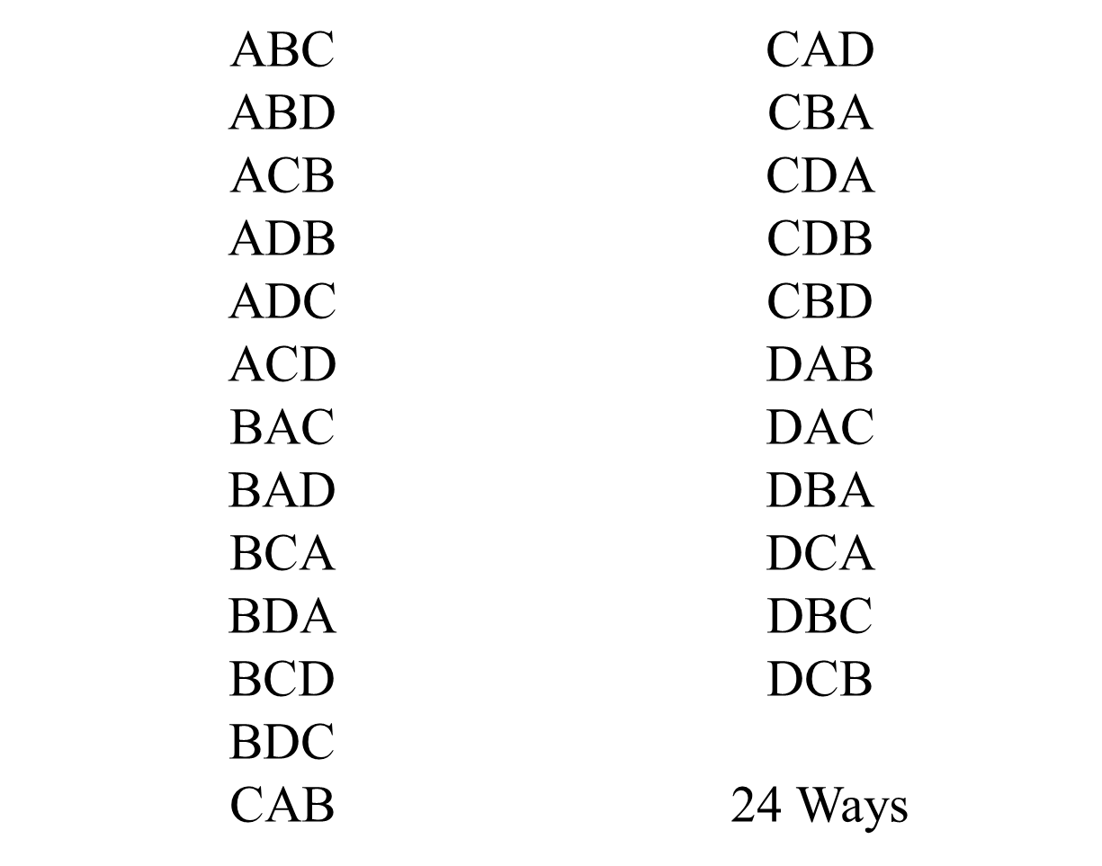

Slide 4
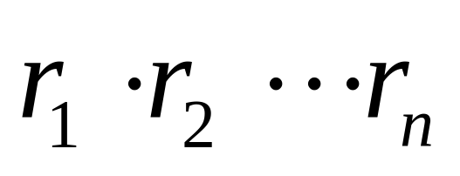
Fundamental Counting Principle
Suppose that a certain procedure P can be broken into n successive ordered stages, S₁, S_{2, . . .} S_{n,} and suppose that
S₁ can occur in r₁ ways.
S₂ can occur in r₂ ways.
S_{n} can occur in r_{n} ways.
Then the number of ways P can occur is

Slide 5
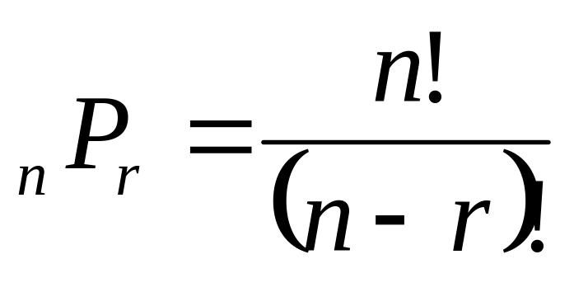
Permutations
An r-permutation of a set of n elements is an ordered selection of r elements from the set of n elements

Slide 6
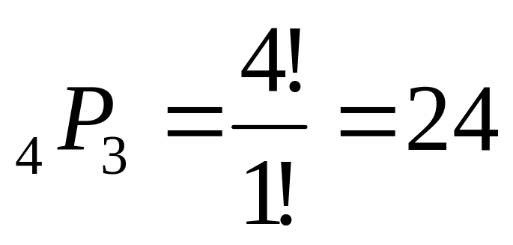
How many three-letter codes are there using letters A, B, C, and D if no letter can be repeated?
Note: The order does matter

Slide 7
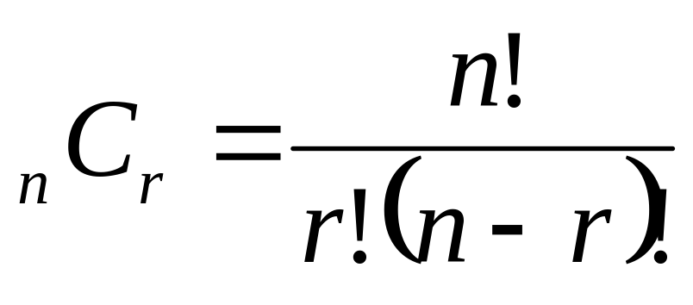
Combinations
The number of combinations of n elements taken r at a time is
Where n & r are nonnegative integers & r < n

Slide 8
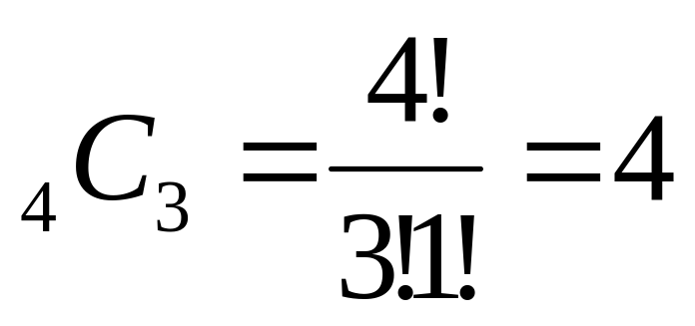
How many committees of three can be selected from four people?
Use A, B, C, and D to represent the people
Note: Does the order matter?

Slide 9
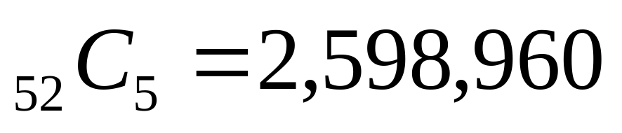
How many five-card hands are possible from a standard deck of cards?

Slide 10
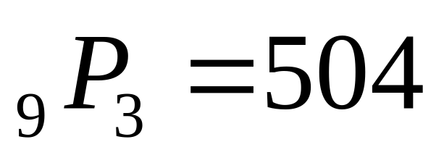
In how many ways can 9 horses place 1st, 2nd, or 3rd in a race?

Slide 11
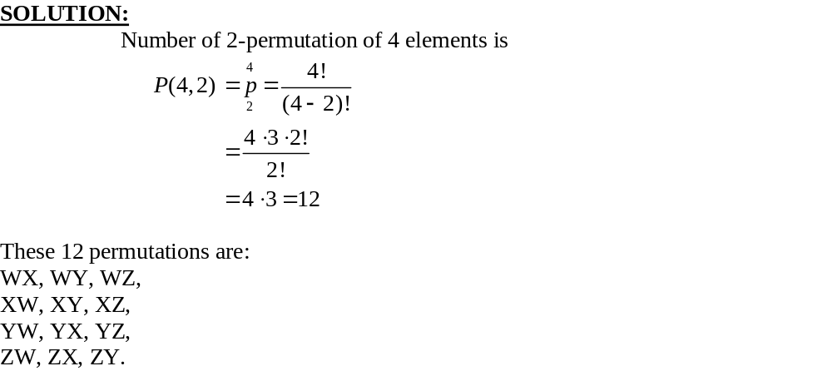
Exercise
How many 2-permutation are there of {W, X, Y, Z}? Write them all.

Slide 12
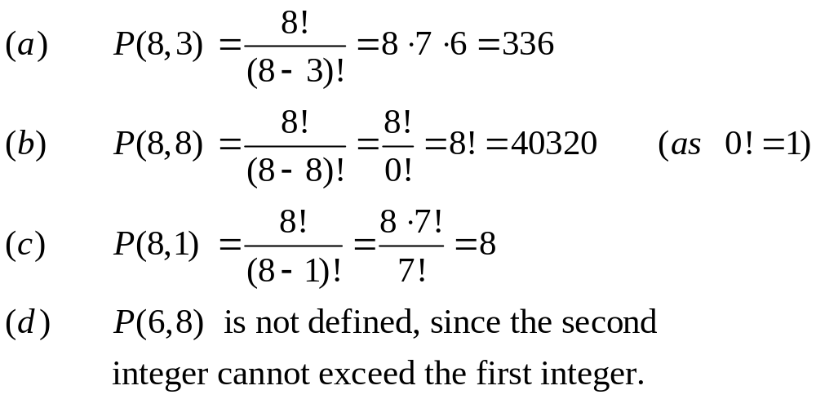
Exercise
Find
(a) P(8, 3) (b) P(8,8)
(c) P(8,1) (d) P(6,8)
Solution

Slide 13
Exercise
Find n if
(a)P(n,2) = 72 (b)P(n,4) = 42 P (n, 2)
SOLUTION:
(a) Given P(n,2) = 72
⇒ n ⋅ (n-1) = 72 (by using the definition of permutation)
⇒ n² -n = 72
⇒ n² - n - 72 = 0
⇒ n = 9, -8
Since n must be positive, so the only acceptable value of n is 9.

Slide 14
Solution
(b) Given P(n,4) = 42P(n,2)
⇒ n (n-1) (n-2) (n-3) = 42 n (n - 1) (by using the definition of permutation)
⇒ (n-2) (n-3) = 42 if n ≠0, n ≠1
⇒ n² - 5n + 6 = 42
or n² - 5n - 36 = 0
or (n-9) (n+4) = 0
⇒ n = 9, -4
Since n must be positive, the only answer is n = 9

Slide 15
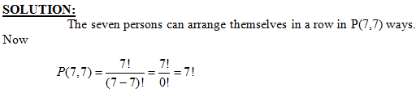
Exercise
Find the number of ways that a party of seven persons can arrange themselves in a row of seven chairs.

Slide 16
Exercise
A debating team consists of three boys and two girls. Find the number n of ways they can sit in a row if the boys and girls are each to sit together.
SOLUTION:
There are two ways to distribute them according to sex: BBBGG or GGBBB.
In each case
the boys can sit in a row in P(3,3) = 3! = 6 ways, and
the girls can sit in
P(2,2) = 2! = 2 ways and
Every row consist of boy and girl which is = 2!=2
Thus
The total number of ways=n = 2 ⋅ 3! ⋅ 2!
= 2 ⋅6 ⋅2 = 24

Slide 17
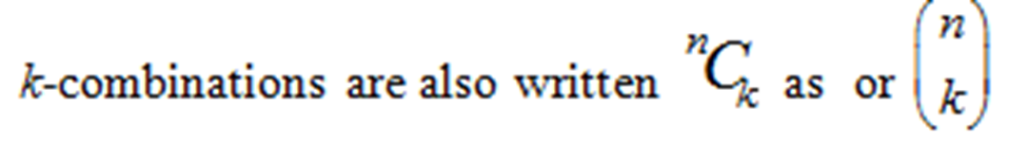
Combination
A k-combination of a set of n elements is a choice of k elements taken from the set of n elements such that the order of the elements does not matter and elements can’t be repeated.
The symbol C(n, k) denotes the number of k-combinations that can be chosen from a set of n elements.

Slide 18
Exercise
Let X = {a, b, c, d, e}.
List all 3-combinations of the 5 elements of the set X, and hence find the value of C(5,3).
SOLUTION:
Then 3-combinations of the 5 elements of the set X are:
{a, b, c}, {a, b, d}, {a, b, e}, {a, c, d}, {a, c, e},
{a, d, e}, {b, c, d}, {b, c, e}, {b, d, e}, {c, d, e}
Hence C(5, 3) = 10

Slide 19
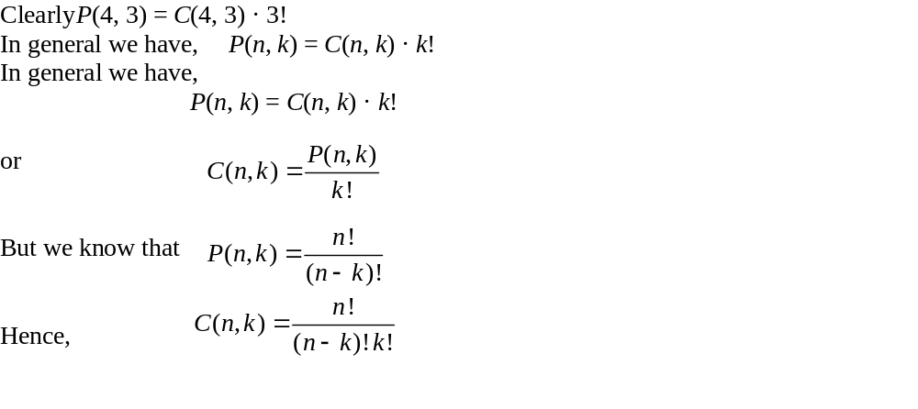
PERMUTATIONS AND COMBINATIONS

Slide 20
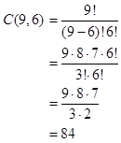
Example
Compute C(9, 6).
Solution:

Slide 21
EXERCISE
A student is to answer eight out of ten questions on an exam.
(a) Find the number m of ways that the student can choose the eight questions
(b) Find the number m of ways that the student can choose the eight questions, if the first three questions are compulsory.
SOLUTION:
(a) The eight questions can be answered in m = C(10, 8) = 45 ways.
(b) The eight questions can be answered in m = C(7, 5) = 21 ways.

Slide 22
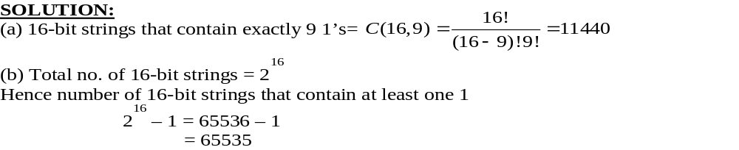
Exercise
(a) How many 16-bit strings contain exactly 9 1’s?
(b)How many 16-bit strings contain at least one 1?

Slide 23
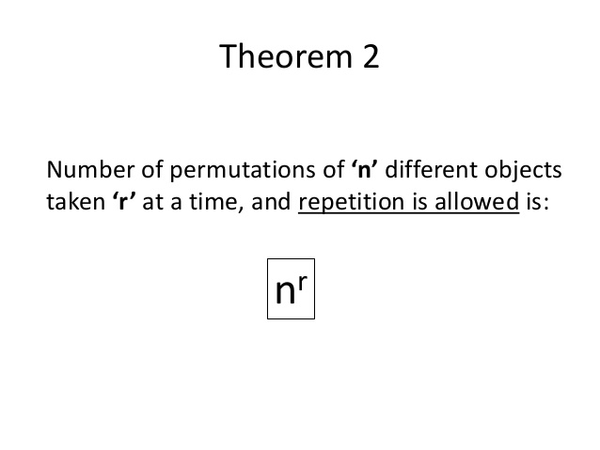

Permutation with repetition

Slide 24
K-SELECTIONS
k-selections are similar to k-combinations in that the order in which the elements are selected does not matter, but in this case repetitions can occur.

Slide 25
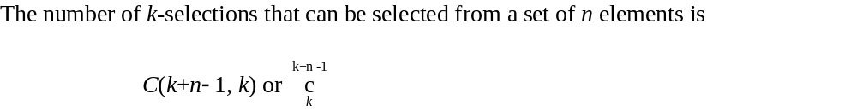
Theorem

Slide 26
Exercise
A camera shop stocks ten different types of batteries.
(a) How many ways can a total inventory of 30 batteries be distributed among the ten different types?
(b) Assuming that one of the types of batteries is A76, how many ways can a total inventory of 30 batteries be distributed among the 10 different types if the inventory must include at least four A76 batteries?

Slide 27
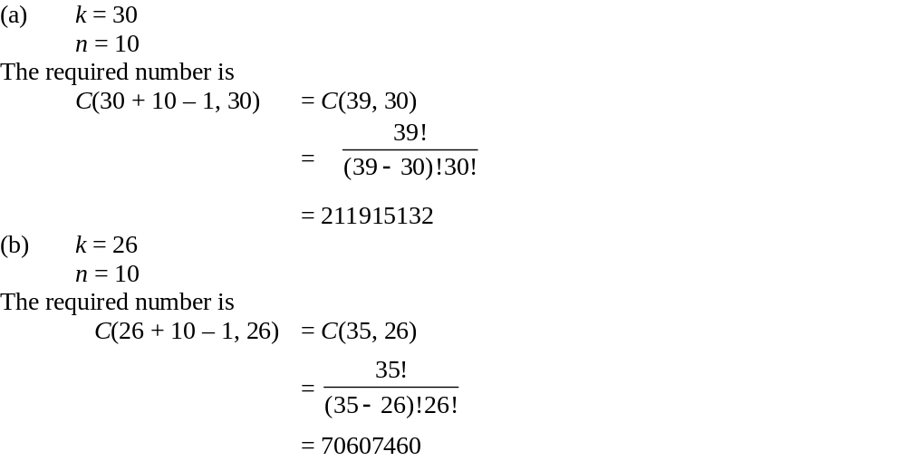
Solution

Slide 28
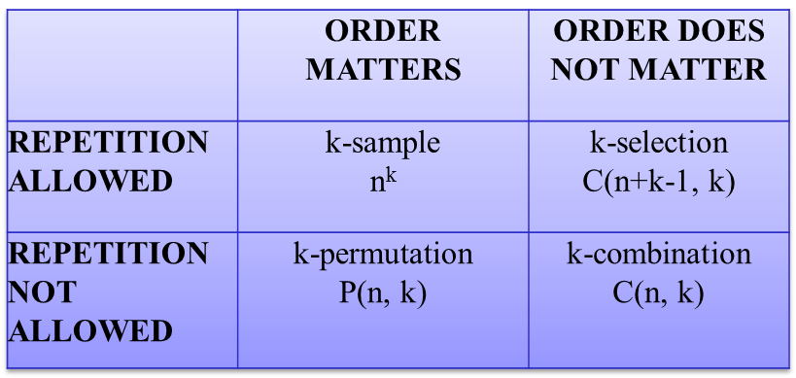
Table with Formulas

Slide 29
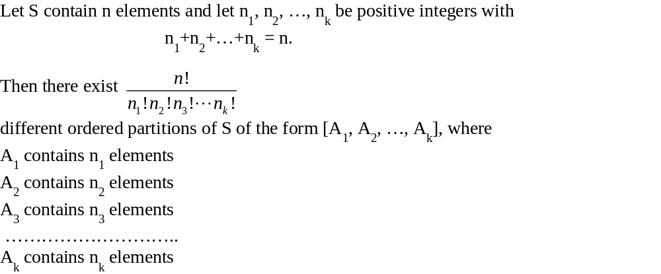
Constrained repition

Slide 30
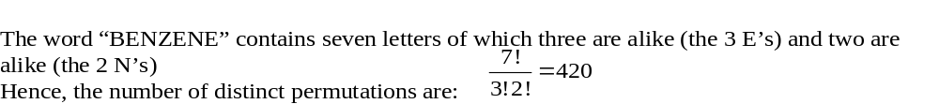
Exercise
Find the number of distinct permutations that can be formed using the letters of the word “BENZENE”.
Solution

Slide 31
Exercise
(i)Find the number of “words” that can be formed of the letters of the word ELEVEN.
(ii)Find, if the words are to begin with L.
(iii)Find, if the words are to begin and end in E.
(iv)Find, if the words are to begin with E and end in N.

Slide 32
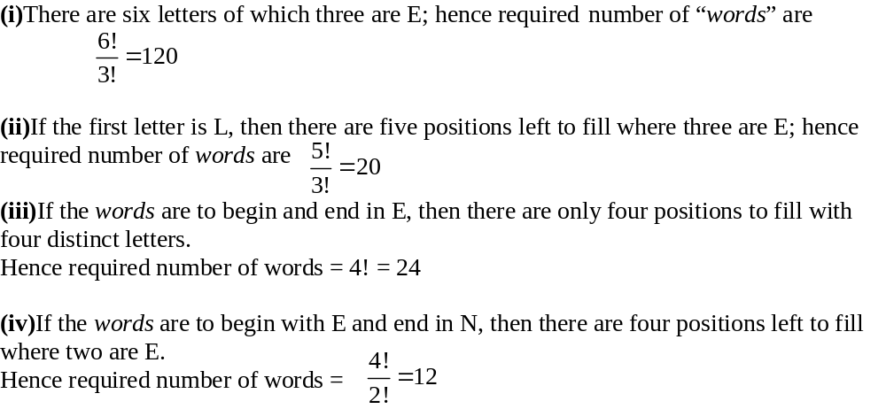
Solution

Slide 33
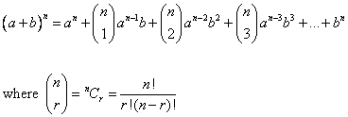
Binomial Theorem
The Binomial Theorem states that

Slide 34
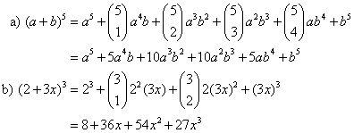
Binomial Coefficient
In the expansion of (a + b)^{n}, the (r +1)^{th} term is
Example:
Expand
a) (a + b)⁵
b) (2 + 3x)³
Solution:

Slide 35


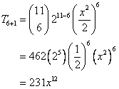
Binomial Coefficient
Example:
Find the 7th term of
solution
Using the formula

